Slide 1
K-12
Undergraduate
Education
Graduate/Postdoc
(First author)
PI
(Corresponding author)
Publication Cycle
Reviewers
Continued Training
Editors
(Text and art)
Audience

Slide 2
Education
Continued Training
K-12
Undergraduate
Graduate/Postdoc
(First author)
PI
(Corresponding author)
Reviewers
Editors
(Text and art)
Audience
Industrial Workforce
Publication Cycle

Slide 3
Hierarchy of Control
Elimination
Most effective
Do not use bar graphs
Substitution
Use correct bar graphs
Engineering Controls
Build warnings in software
Administrative
Controls
Data science awareness of personnel in publication cycle
PPE
Data science awareness of audience
Least effective

Slide 4
a
Education
Continued Training
K-12
Undergraduate
Graduate/Postdoc
(First author)
PI
(Corresponding author)
Reviewers
Editors
(Text and art)
Audience
Industrial Workforce
Publication Cycle
Most effective
Least effective
b
Hierarchy of Control
Data visualization standard
Data science education
Elimination
Substitution
Engineering
Control
Administrative
Control
PPE
Correct data interpretation
Do not use bar graphs (Extended Data Fig. 10)
Use box and violin plots
Show raw data
Use bar graphs correctly (Extended Data Fig. 1-5)
Build warnings in software to prevent incorrect axes
Provide data science warning and guidance in documentations
Improve data science training in publication cycle at all levels
Establish journal data visualization checklist
Improve data science education and literacy for audience at all levels

Slide 5
a
Most effective
Least effective
Education
Continued training
K-12
Undergraduate
Graduate/Postdoc
(First author)
PI
(Corresponding author)
Reviewers
Editors
(Text and art)
Audience
Industrial workforce
Publication cycle
b
Hierarchy of Control
Data visualization standard
Data science education
Elimination
Substitution
Engineering
control
Administrative
control
PPE
Correct data interpretation
Do not use bar graphs (Extended Data Fig. 2, 5, 10)
Choose box and violin plots that show data distribution
Use bar graphs correctly (Extended Data Fig. 1, 3, 4)
Show raw data
Build warnings in software to prevent incorrect axes
Provide data science warning and guidance in documentations
Improve data science training in publication cycle at all levels
Establish journal data visualization checklist
Improve data science education and literacy for audience at all levels

Slide 6
a
Most effective
Least effective
Education
Continued training
K-12
Undergraduate
Graduate/Postdoc
(First author)
PI
(Corresponding author)
Reviewers
Editors
(Text and art)
Audience
Industrial workforce
Publication cycle
b
Hierarchy of Control
Data visualization standard
Data science education
Elimination
Substitution
Engineering
control
Administrative
control
PPE
Correct data interpretation
Do not use bar graphs (Extended Data Fig. 2, 5, 10)
Choose box and violin plots that show data distribution
Use bar graphs correctly (Extended Data Fig. 1, 3, 4)
Show raw data
Build warnings in software to prevent incorrect axes
Provide data science warning and guidance in documentations
Improve data science training in publication cycle at all levels
Establish journal data visualization checklist
Improve data science education and literacy for audience at all levels

Slide 7
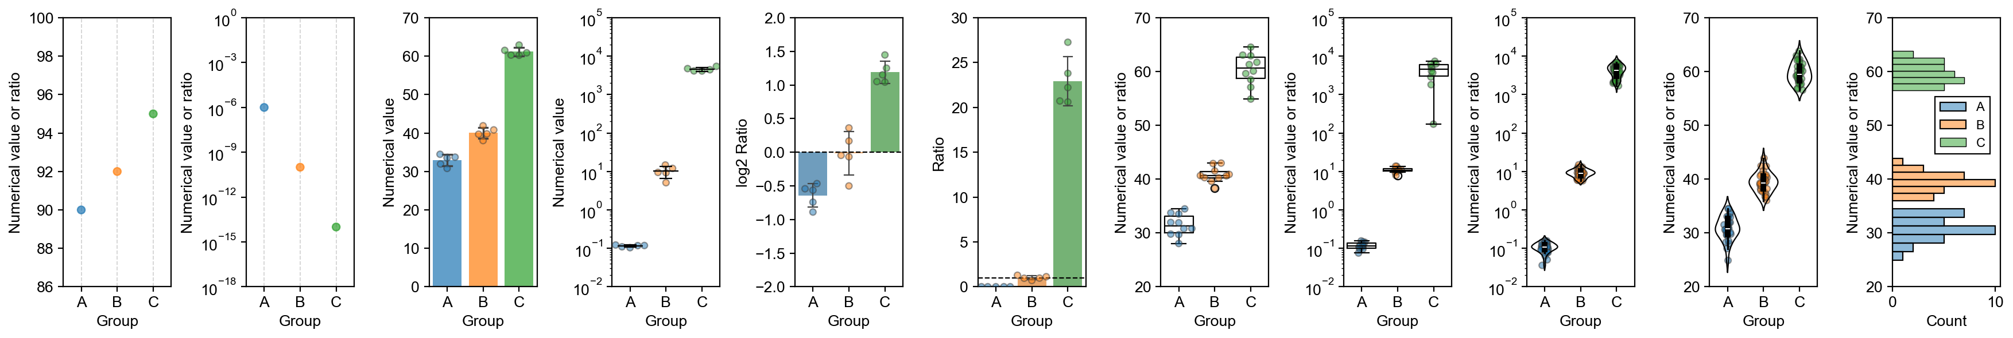
a
Sample size
n = 1
1 ≤ n ≲ 5
1 < n ≲ 5
1 ≤ n ≲ 5
5 ≲ n ≲ 30
n ≳ 30
Scale
Linear
Log
Linear
Log
Linear
Log
Log
Linear
Quantity
Absolute or Ratio
Absolute
Absolute
Ratio (relative)
Ratio (absolute)
Absolute or Ratio
Example
graphs
Graph type
Dot plots
Bar graphs
Mean-and-error
Bar graphs
Box plots
Violin plots
Histograms
b
Graph type | Sample size | Axis scale |  | Difference
 |  | Linear | Log | Absolute difference | Fold difference | Relative difference
Point plot | n = 1 | ✓ | ✓ | ✓
Bar plot | 1 ≤ n ≲ 5 | ✓ |  |  | ✓ | ✓
Mean-and-error plot | 1 < n ≲ 5 | ✓ | ✓ | ✓
Box plot | 5 ≲ n ≲ 30 | ✓ | ✓ | ✓
Violin plot | n ≳ 30 | ✓ | ✓ | ✓
Histogram | n ≳ 30 | ✓ |  | ✓

Slide 8
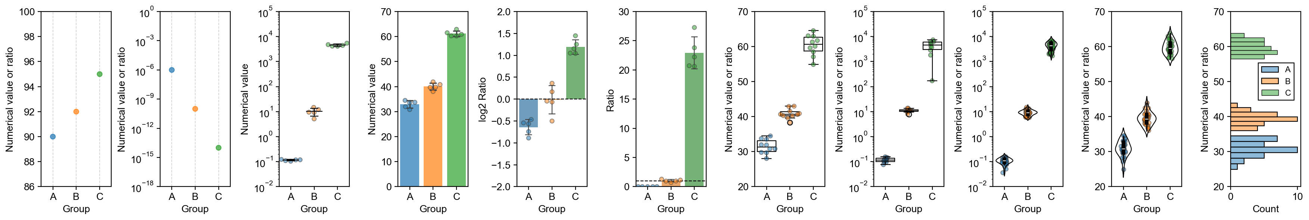
Sample size
n = 1
1 < n ≲ 5
1 ≤ n ≲ 5
5 ≲ n ≲ 30
n ≳ 30
Scale
Linear
Log
Linear
Log
Linear
Linear
Log
Log
Linear
Quantity
Absolute or Ratio
Absolute
Absolute
Ratio (relative)
Ratio (absolute)
Absolute or Ratio
Example
graphs
Graph type
Dot plots
Mean-and-error
Bar graphs
Box plots
Violin plots
Histograms

Slide 9
Graph type | Sample size per group | Axis scale |  | Change
 |  | Linear | Log | Absolute change | Fold change | Relative change
Point plot | n = 1 | ✓ | ✓ | ✓
Bar plot | 1 ≤ n ≲ 5 | ✓ |  |  | ✓ | ✓
Mean-and-error plot | 1 < n ≲ 5 | ✓ | ✓ | ✓
Box plot | 5 ≲ n ≲ 30 | ✓ | ✓ | ✓
Violin plot | n ≳ 30 | ✓ | ✓ | ✓
Histogram | n ≳ 30 | ✓ |  | ✓
Graph type | Sample size per group | Axis scale |  | Change
 |  | Linear | Log | Absolute change | Fold change | Relative change
Point plot | n = 1 | ✓ | ✓ | ✓
Lollipop plot | n = 1 | ✓ |  |  | ✓ | ✓
Bar plot | 1 ≤ n ≲ 5 | ✓ |  |  | ✓ | ✓
Mean-and-error plot | 1 < n ≲ 5 | ✓ | ✓ | ✓
Box plot | 5 ≲ n ≲ 30 | ✓ | ✓ | ✓
Violin plot | n ≳ 30 | ✓ | ✓ | ✓
Histogram | n ≳ 30 | ✓ |  | ✓

Slide 10
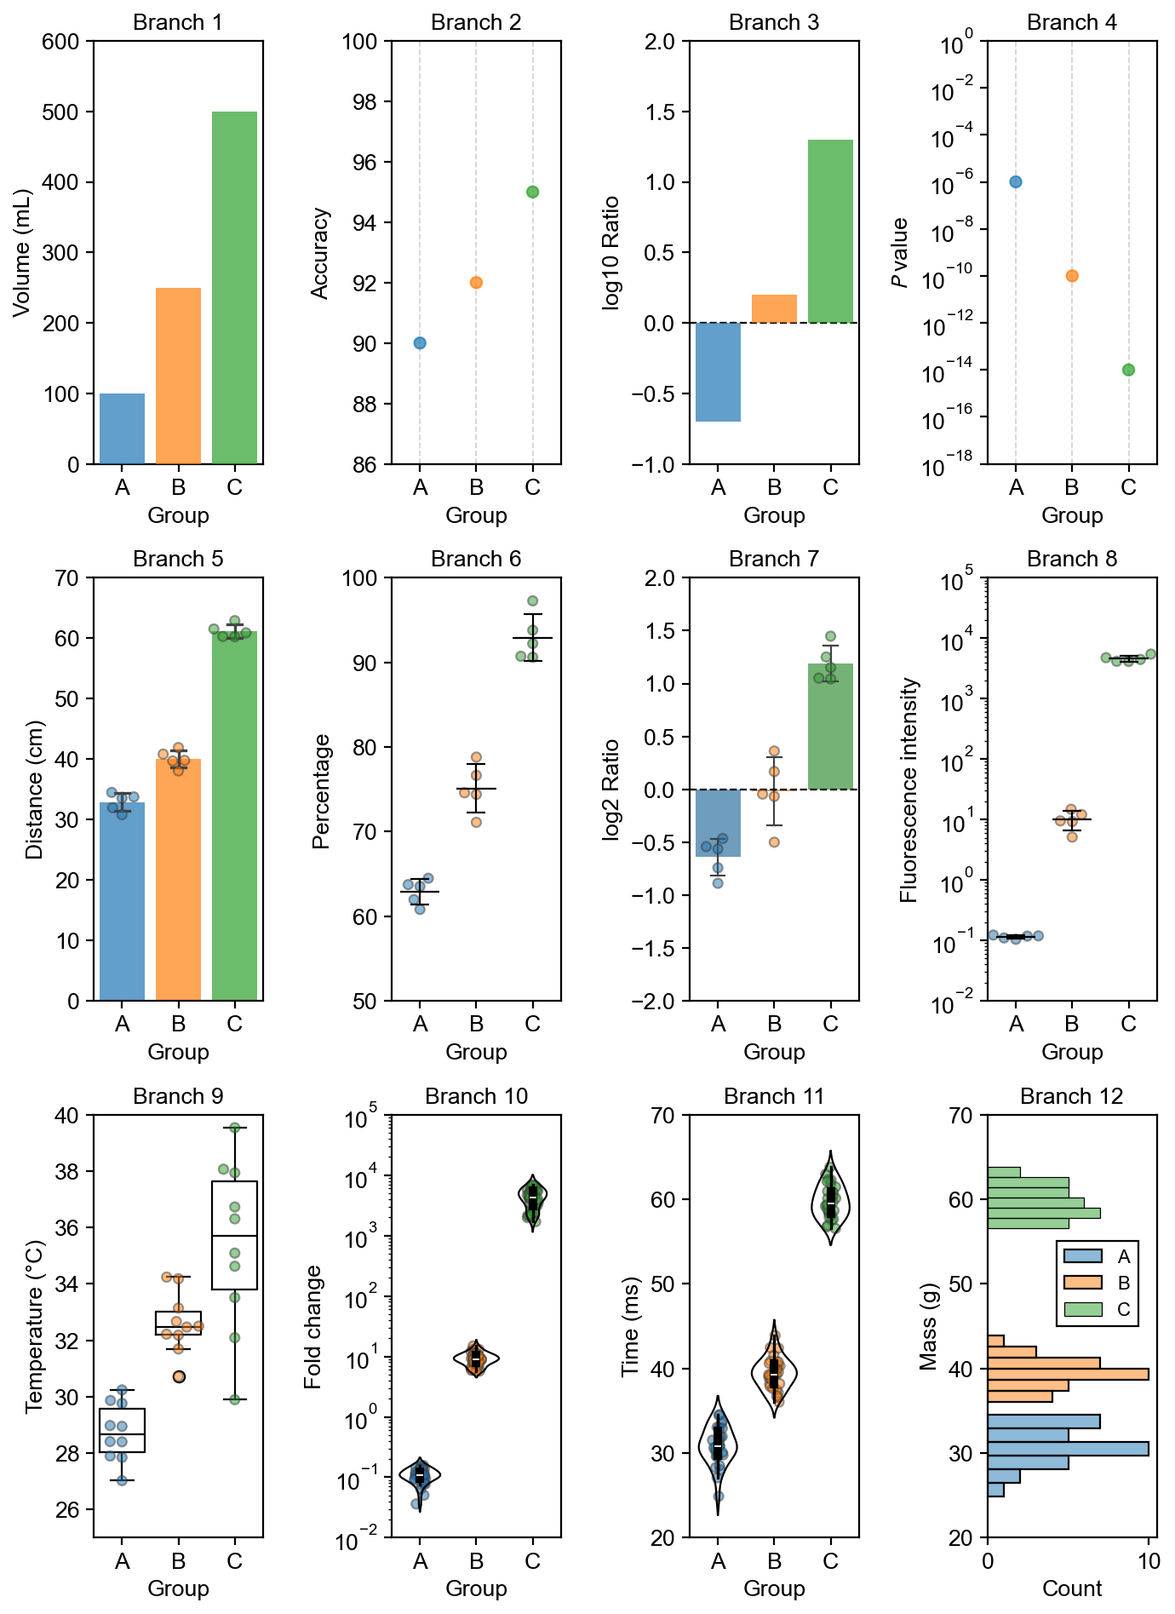
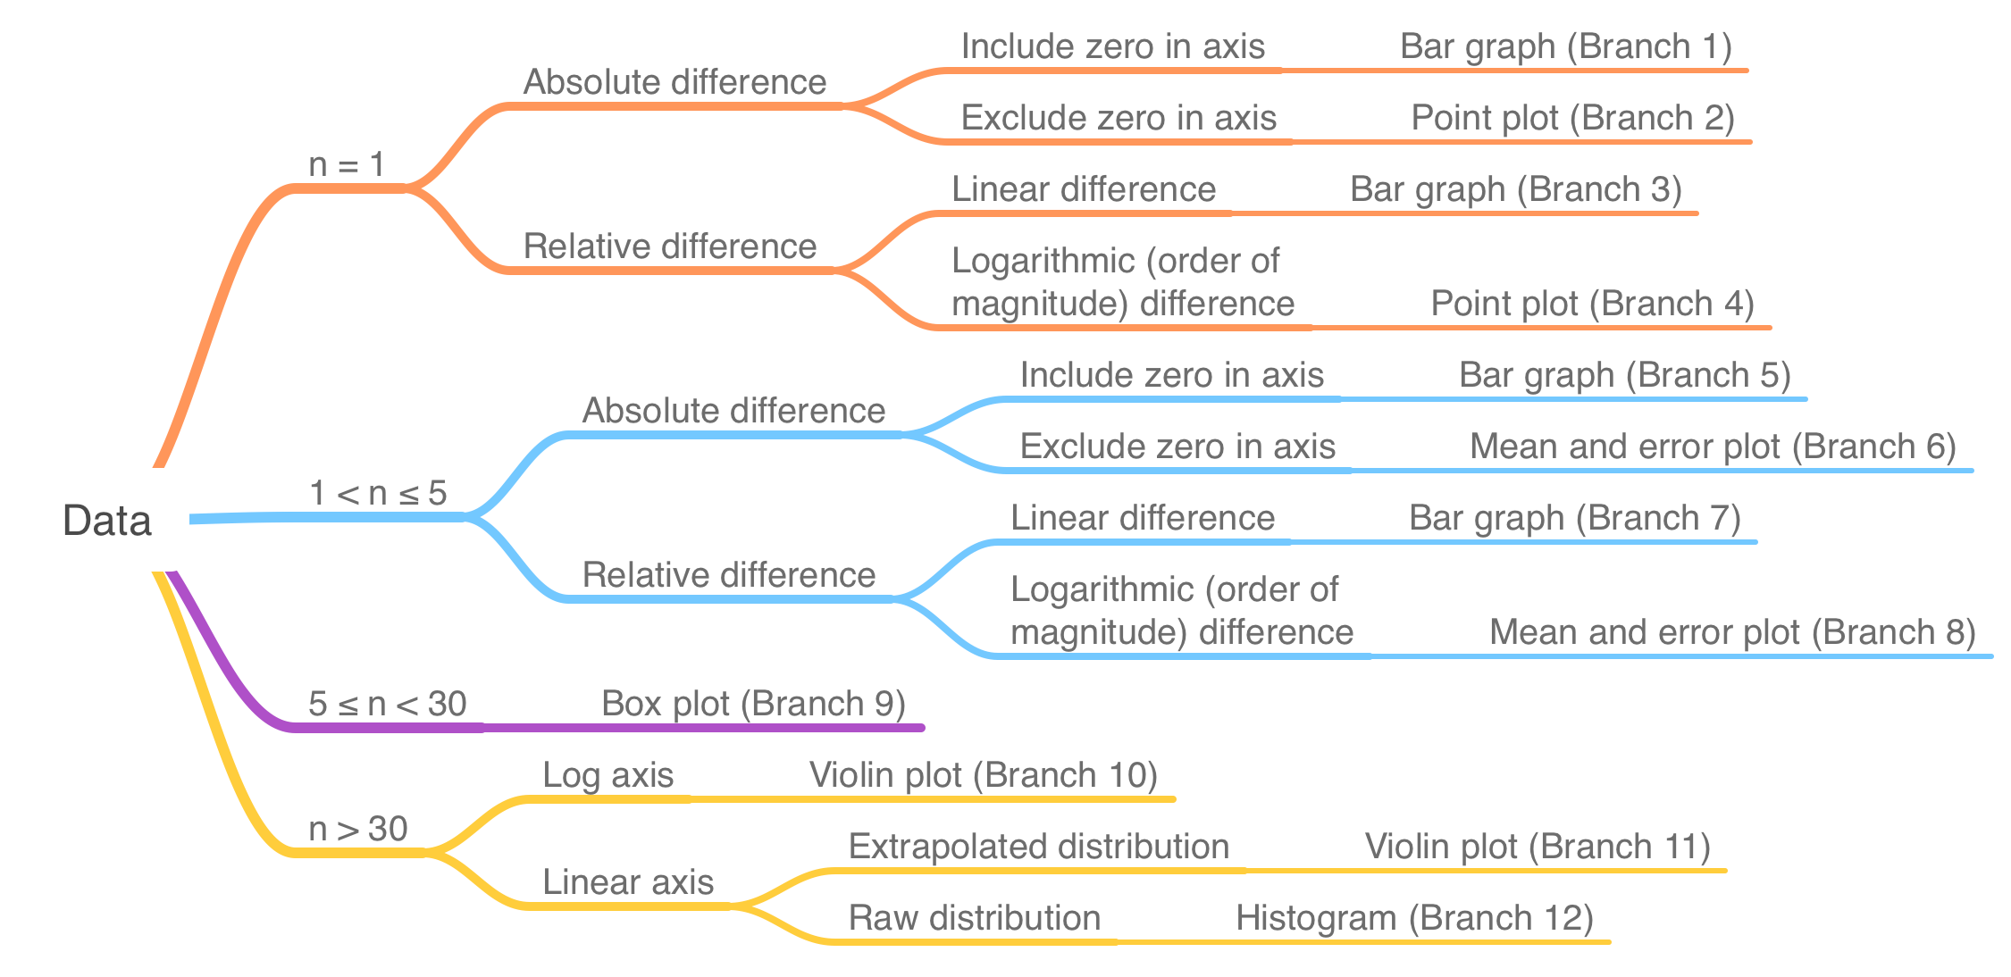
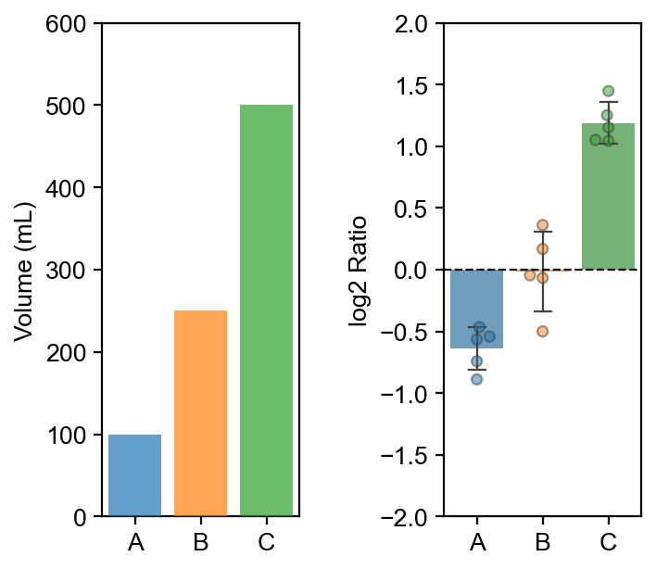
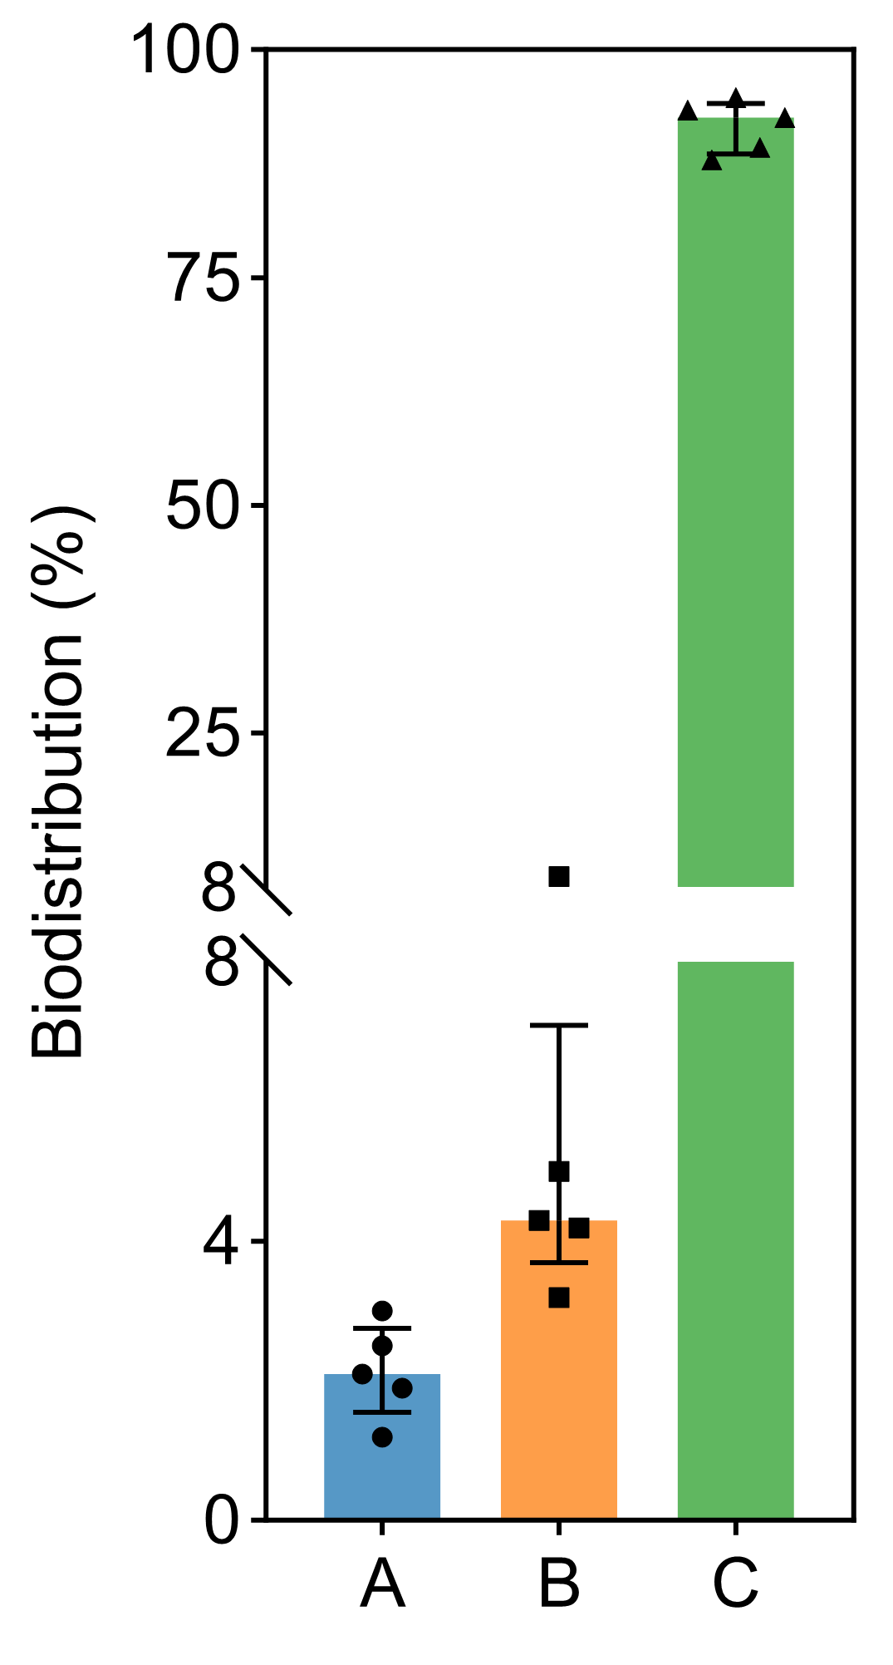
a
Graph type | Sample size per group | Axis scale |  | Difference
 |  | Linear | Log | Absolute difference | Fold difference | Relative difference
Point plot | n = 1 | ✓ | ✓ | ✓
Bar graph | 1 ≤ n ≲ 5 | ✓ |  |  | ✓ | ✓
Mean-and-error plot | 1 < n ≲ 5 | ✓ | ✓ | ✓
Box plot | 5 ≲ n ≲ 30 | ✓ | ✓ | ✓
Violin plot | n ≳ 30 | ✓ | ✓ | ✓
Histogram | n ≳ 30 | ✓ |  | ✓
e
b
Data
c
d
Linear axis
Show raw data
2D bars
≥ 2 bars
Consistent width
Quantity with defined relative difference
Break
bars
Shows raw data
Ticks axis
Label values
at breaks
≥ 2 bars
below break
Starts at 0
Labels 0
Starts at 0
Labels 0
Nominal variables

Slide 11
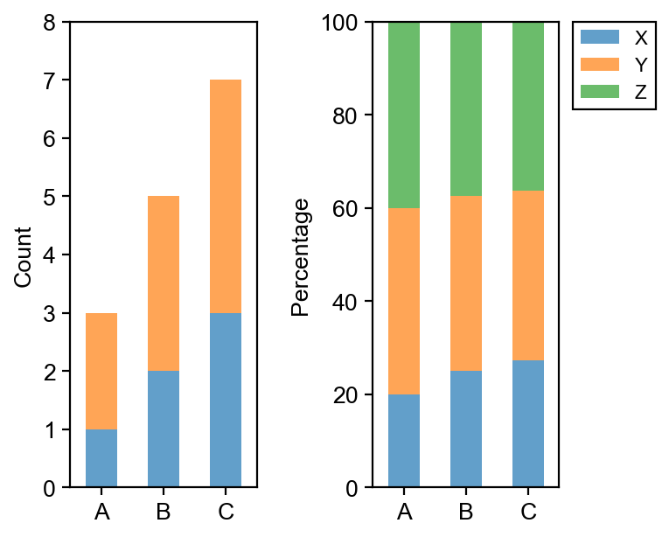
a
Most effective
Least effective
Education
Continued training
K-12
Undergraduate
Graduate/Postdoc
(First author)
PI
(Corresponding author)
Reviewers
Editors
(Text and art)
Audience
Industrial workforce
Publication cycle
b
Hierarchy of Control
Data visualization standard
Data science education
Elimination
Substitution
Engineering
control
Administrative
control
PPE
Correct data interpretation
Do not use bar graphs (Fig. 2d, Extended Data Fig. 2, 5, 10)
Choose box and violin plots that show data distribution
Use bar graphs correctly (Fig. 2e-g, Extended Data Fig. 1, 3, 4)
Show raw data
Build warnings in software to prevent incorrect axes
Provide data science warning and guidance in documentations
Improve data science training in publication cycle at all levels
Establish journal data visualization checklist
Improve data science education and literacy for audience at all levels
c
d
Graph type | Sample size per group | Axis scale |  | Change
 |  | Linear | Log | Absolute change | Fold change | Relative change
Point plot | n = 1 | ✓ | ✓ | ✓
Lollipop plot | n = 1 | ✓ |  |  | ✓ | ✓
Bar plot | 1 ≤ n ≲ 5 | ✓ |  |  | ✓ | ✓
Mean-and-error plot | 1 < n ≲ 5 | ✓ | ✓ | ✓
Box plot | 5 ≲ n ≲ 30 | ✓ | ✓ | ✓
Violin plot | n ≳ 30 | ✓ | ✓ | ✓
Histogram | n ≳ 30 | ✓ |  | ✓
Data
e
f
g
Linear axis
Shows raw data
2D bars
≥ 2 bars
≤ 2 stacks
Consistent width
Legend
Quantity with defined relative difference
Breaks
bars
≤ 3 stacks
Shows raw data
Labels values at break
No breaks
Ticks axis
≥ 2 bars
below break
Starts at 0
Labels 0
Nominal
variables
Starts at 0
Labels 0

Slide 12
a
Early intervention
Late intervention
Education
Continued training
K-12
Undergraduate
Graduate/Postdoc
(First author)
PI
(Corresponding author)
Reviewers
Editors
(Text and art)
Audience
Publication cycle
b
Hierarchy of Controls
Data visualization standard
Data science education
Elimination
Substitution
Engineering
control
Administrative
control
PPE
Correct data interpretation
Do not use bar graphs (Fig. 2d, Extended Data Fig. 2, 5, 10)
Choose box and violin plots that show data distribution
Use bar graphs correctly (Fig. 2e-g, Extended Data Fig. 1, 3, 4)
Show raw data
Build warnings in software to prevent incorrect axes
Provide data science warning and guidance in documentations
Improve data science training in publication cycle at all levels
Establish journal data visualization checklist
Improve data science education and literacy for audience at all levels
c
d
Graph type | Sample size per group | Axis scale |  | Change
 |  | Linear | Log | Absolute change | Fold change | Relative change
Point plot | n = 1 | ✓ | ✓ | ✓
Lollipop plot | n = 1 | ✓ |  |  | ✓ | ✓
Bar plot | 1 ≤ n ≲ 5 | ✓ |  |  | ✓ | ✓
Mean-and-error plot | 1 < n ≲ 5 | ✓ | ✓ | ✓
Box plot | 5 ≲ n ≲ 30 | ✓ | ✓ | ✓
Violin plot | n ≳ 30 | ✓ | ✓ | ✓
Histogram | n ≳ 30 | ✓ |  | ✓
Data
e
f
g
Linear axis
Cartesian coordinates
Shows raw data
2D bars
≥ 2 bars
≤ 2 stacks
Consistent width
Legend
Measurand with defined relative difference
Shows raw data
Breaks
bars
≤ 3 stacks
Labels values at break
No breaks
Ticks axis
≥ 2 bars
below break
Starts at 0
Labels 0
Nominal
variables
Starts at 0
Labels 0

Slide 13
Early intervention
Late intervention
Education
Continued training
K-12
Undergraduate
Graduate/Postdoc
(First author)
PI
(Corresponding author)
Reviewers
Editors
(Text and art)
Audience
Publication cycle
Hierarchy of Controls
Data visualization standard
Data science education
Elimination
Substitution
Engineering
control
Administrative
control
PPE
Correct data interpretation
Do not use bar graphs
Choose box and violin plots that show data distribution
Use bar graphs correctly
Show raw data
Build warnings in software to prevent incorrect axes
Provide data science warning and guidance in documentations
Improve data science training in publication cycle at all levels
Establish journal data visualization checklist
Improve data science education and literacy for audience at all levels

Slide 14
Linear axis
Cartesian coordinates
Shows raw data
2D bars
≥ 2 bars
Measurand with defined relative difference
Consistent width
Shows raw data
Breaks
bars
Labels values at break
Ticks axis
≥ 2 bars
below break
Starts at 0
Labels 0
Nominal
variables
Starts at 0
Labels 0

